Slide 1
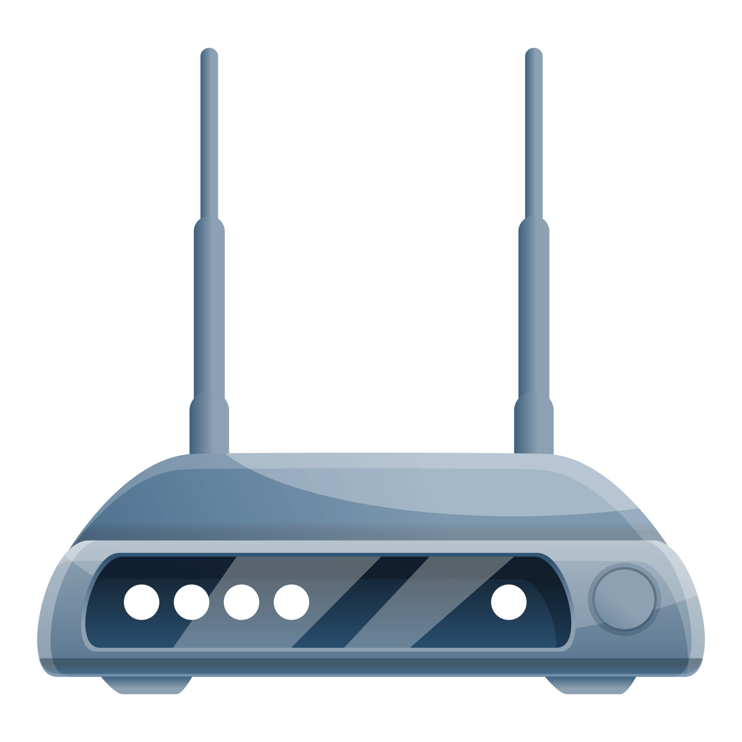



WLAN EDGE COMPUTER
Supervised by - Dr. Sampath Edirisinghe
Team Members -
18/ENG/112 - Pasindu Uduwela
18/ENG/080 - Kesara Premabandhu
18/ENG/062 - Thisari Madurapperuma
18/ENG/037 - Charuka Jayamali

Slide 2

Content
Introduction
Cloud Computing Vs Edge Computing
Architecture
Video Surveillance App
Smart Home App
Conclusion
Q & A

Slide 3
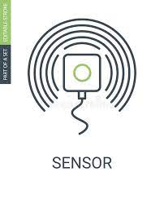

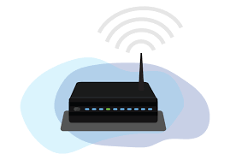

Introduction
WLANs are wireless networks that provide high-speed Internet and network connections.
Example- Wifi
Edge computing is a distributed computing paradigm that brings computation and data storage closer to the sources of data.
WLAN edge computing is used instead of cloud computing, In this case we use an on premises server to deploy smart applications.
Sensors
CC TV
Router
Devices

Slide 4
Cloud Computing Vs Edge Computing
Cloud Computing | Edge Computing
The transmission of large video files over the internet can result in significant delays. | Data processing at the edge reduces the time it takes for data to travel.
The transmission of sensitive video data over the internet raises security concerns. | The risk of data being intercepted in transit is reduced.
Can be prone to outages or slowdowns. | Ensures data is processed even if there is an internet outage.
Requires a large amount of bandwidth. | Reduces the demand on network bandwidth.
Expensive | Cost effective
Privacy concerns for sensitive data | Ensures the privacy
Notes:
Edge servers have several benefits over cloud computing in certain situations:
Low Latency: Edge servers are located closer to end-users, reducing the latency and improving the performance of applications and services.
Improved Bandwidth: Edge servers can offload some of the processing and storage workload from the cloud, reducing the amount of data that needs to be transmitted over the network and improving the overall bandwidth.
Reduced Dependency on Network Connectivity: Edge servers can provide some level of redundancy and ensure that applications and services are still available even if the network connection to the cloud is lost or degraded.
Better Security: Edge servers can help improve the security of data and applications by processing sensitive data locally and reducing the risk of data breaches.
Cost Savings: In some cases, using edge servers can result in cost savings as it reduces the amount of data transmitted over the network, and reduces the need for expensive cloud infrastructure

Slide 5
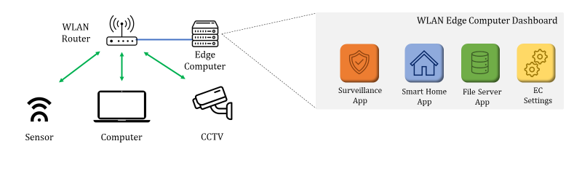
WLAN Edge Computing

Slide 6
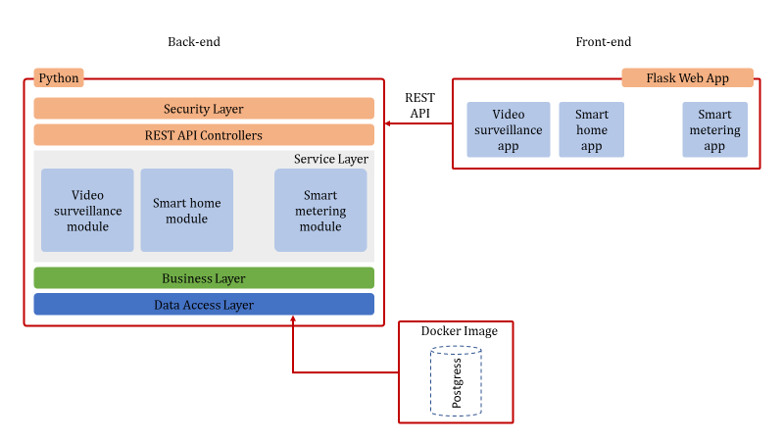
Overall architecture

Slide 7
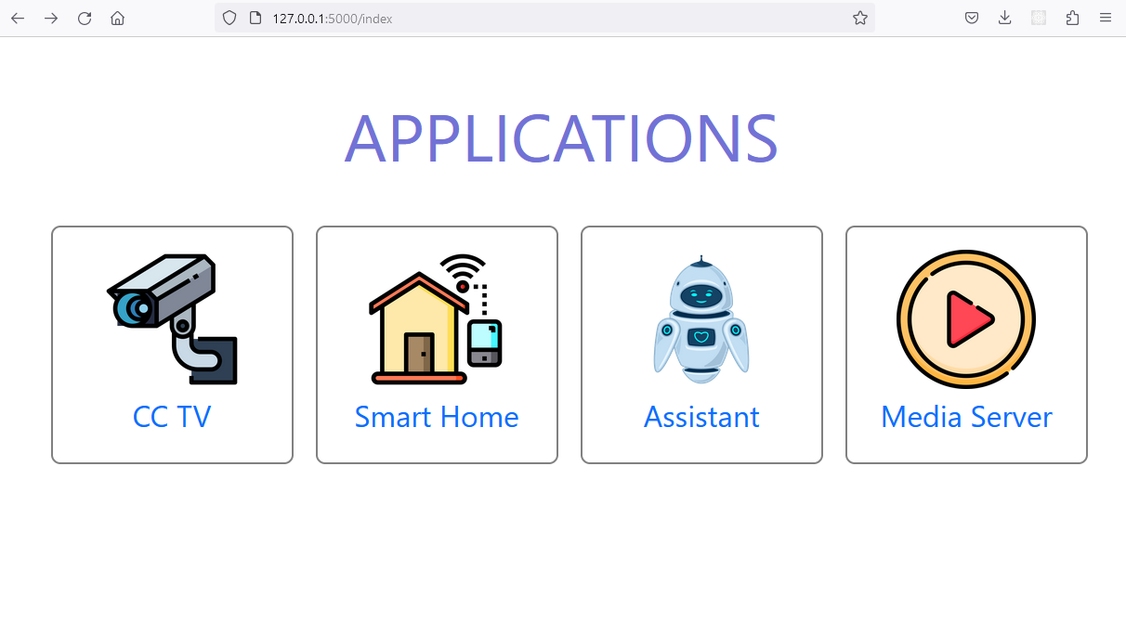
Frontend - App View

Slide 8
Individual app development for demonstration
Video Surveillance App- Processing CCTV Feed for Threat detection
Smart Home App- Monitoring and control smart home devices
Media files server App - Home media server

Slide 9
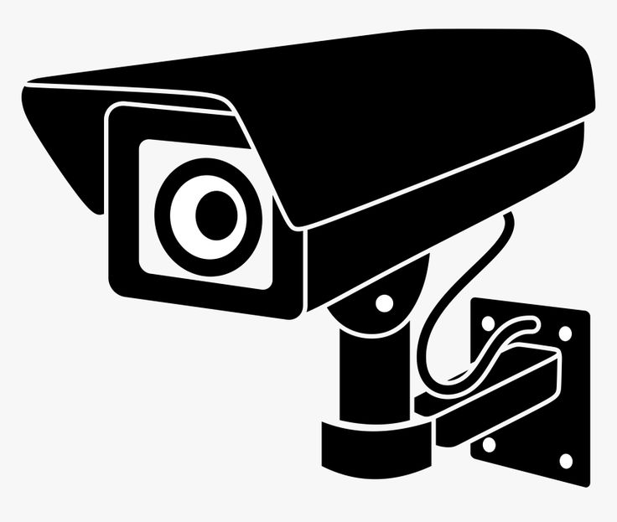

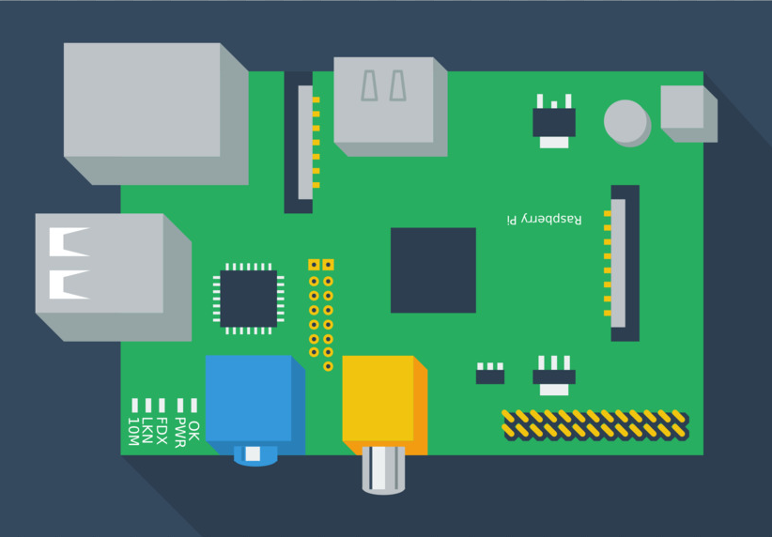
Video surveillance App
Raspberry pi
Edge Computer
WiFi Router
CCTV cameras

Slide 10
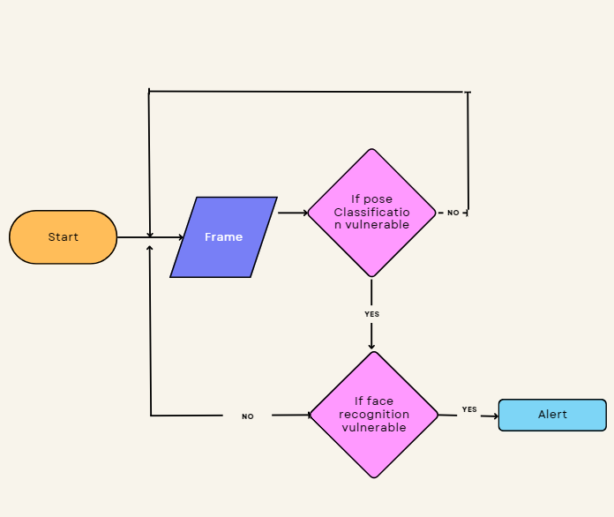
Surveillance video processing
WLAN edge computing provides a more efficient and secure solution for surveillance video processing applications.
This module has two parts.
Pose classification to detect vulnerable poses
Face recognition

Slide 11
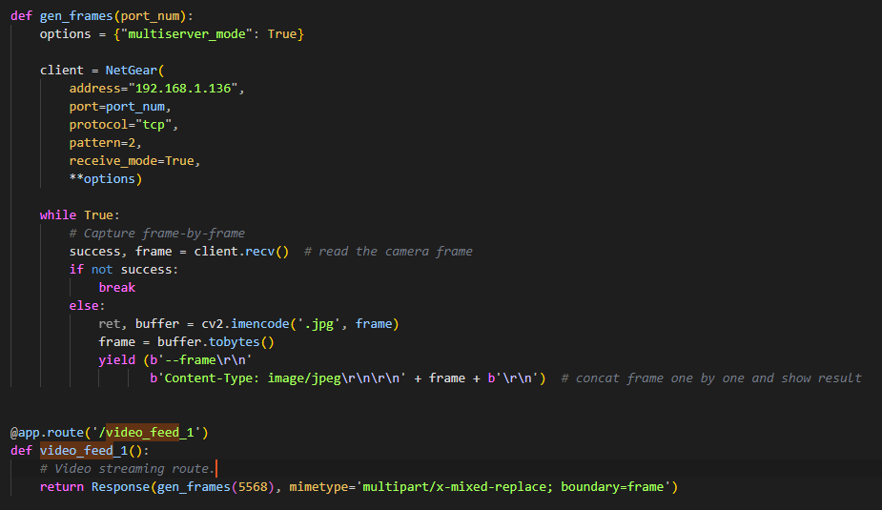
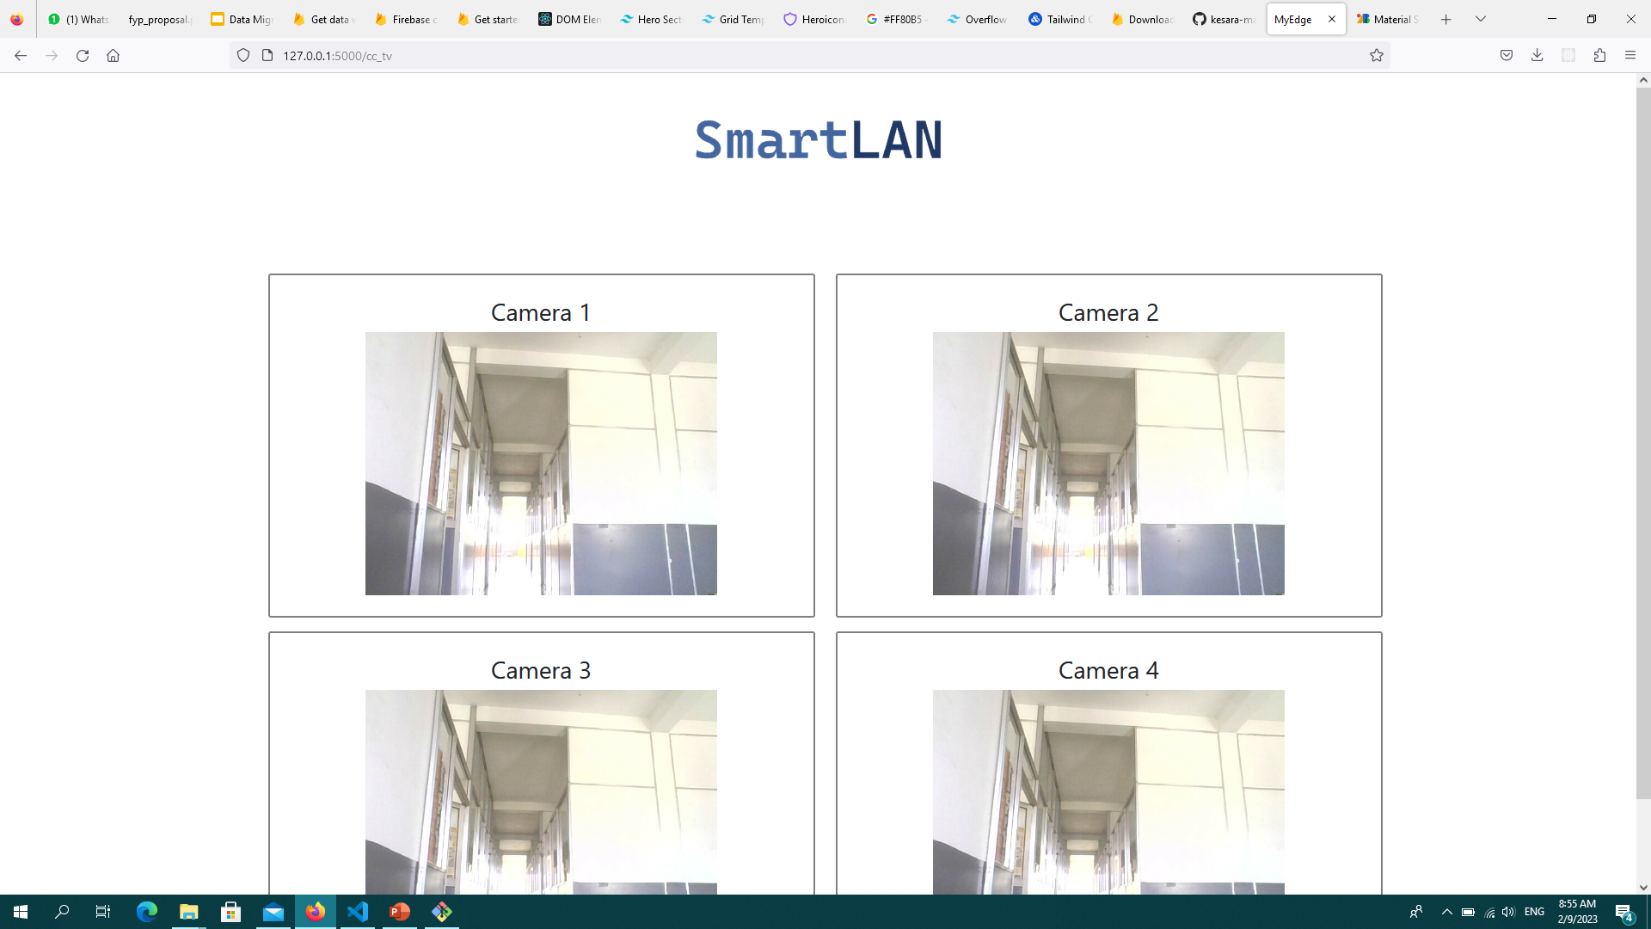
Video Surveillance App - Frontend development
Receiving video streams over wifi network to be displayed in web application

Slide 12
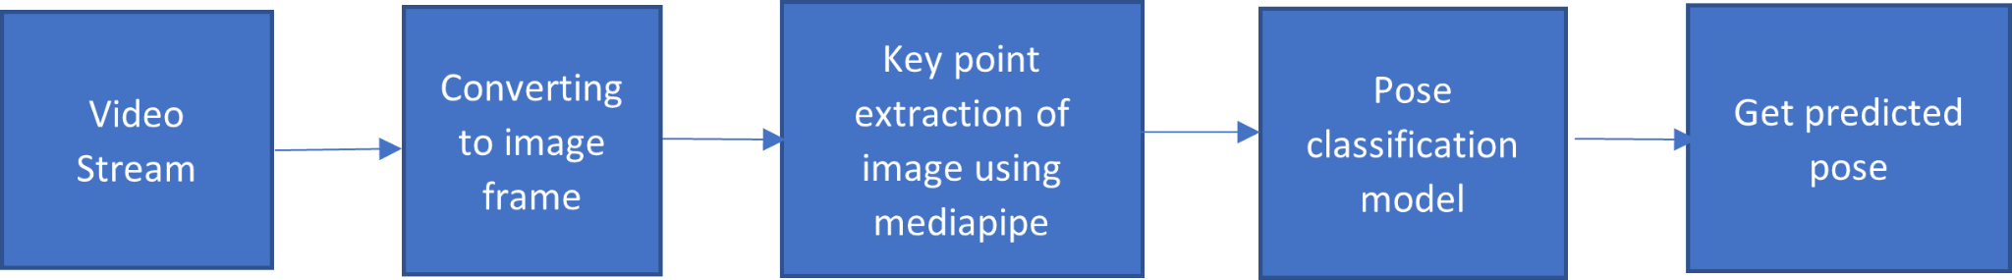
Pose Classification
Training process
Get Predictions from trained model
Dataset
Key point extraction using mediapipie
Save key points to csv file
Train csv data with random forest classifier
Save model

Slide 13
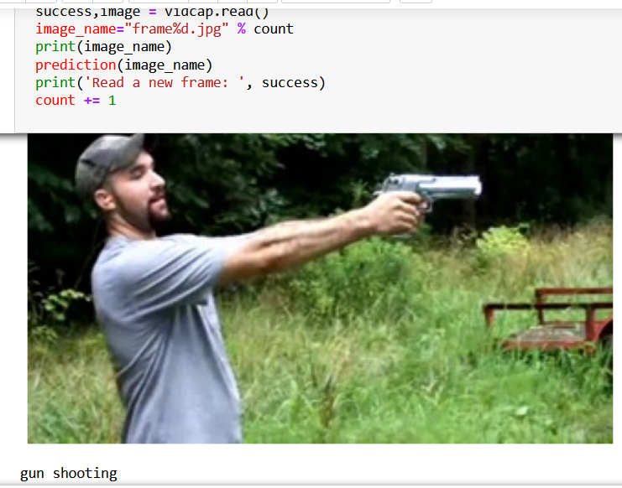
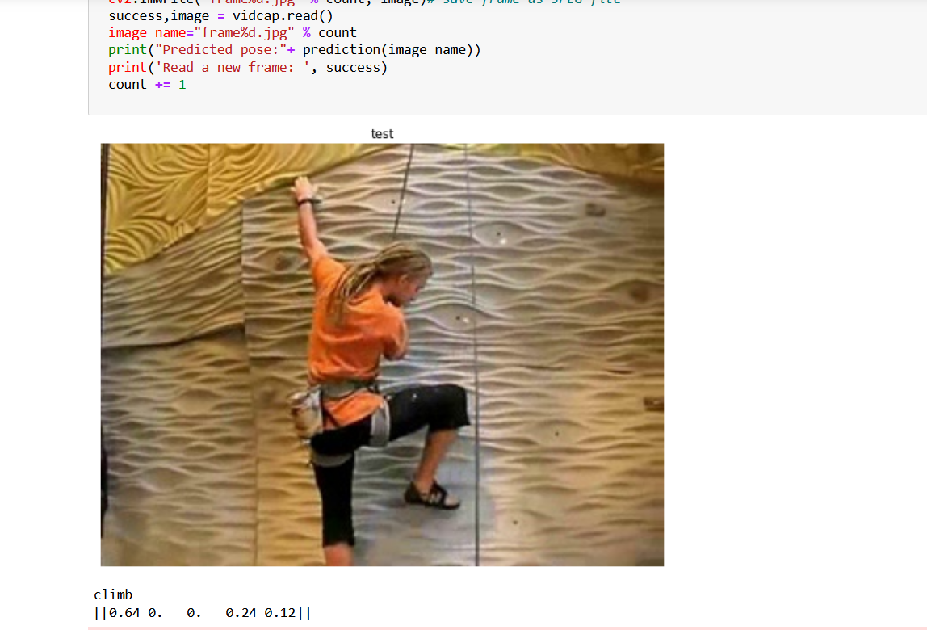
Pose classification model(On going)
Future improvements
Integrate the pose classification model with the face detection model
Ensure the surveillance video processing application working with ip camera feed
Deploying the model in edge server

Slide 14
Face Recognition
Process of registering a new face
Face Recognition Process
Getting the videocapture of a person
Training the captured frames using frontal_face haar cascade classifier
Saving the face as a known face
videocapture
Recognizingthe captured frames using frontal_face haar cascade classifier
Displaying the corresponding name or ‘Unknown’ for an unrecognized face

Slide 15
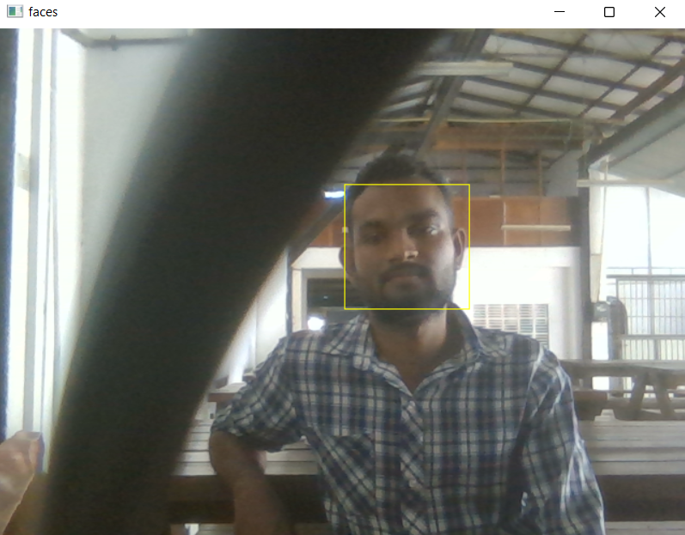
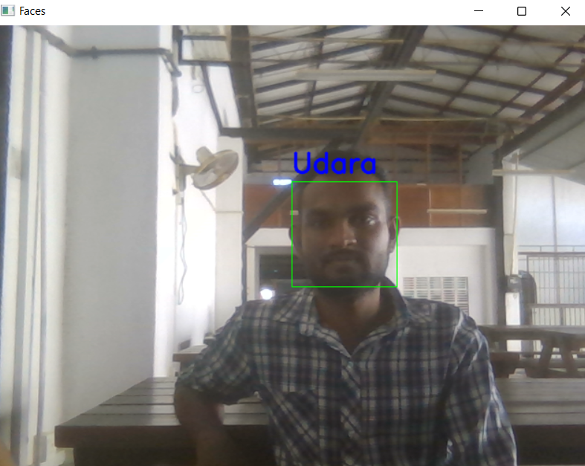
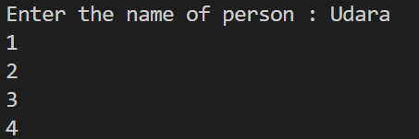
Recognition Model (Ongoing)
Recognizing the face
Saving the face with the corresponding name

Slide 16
Detection process
videocapture
Detecting faces using the frontal_face_default haar cascade classifier
Displaying the number of faces detected
Future Improvements
Recognizing multiple faces when present
Adding Spoofing
Enhancing the accuracy of recognizing distant faces

Slide 17
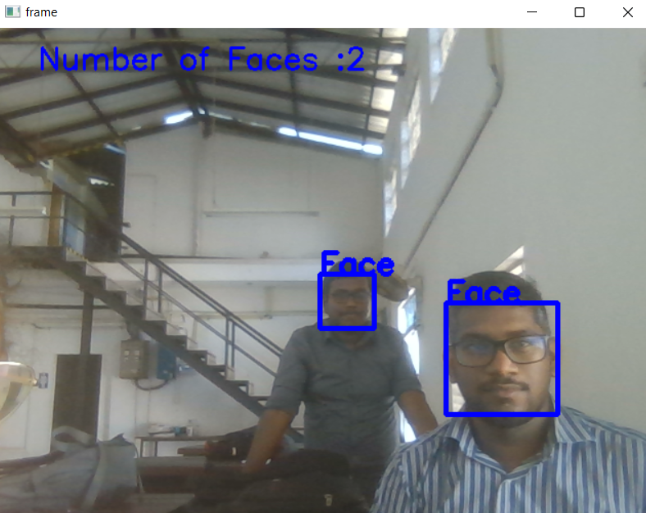
Detecting the faces

Slide 18
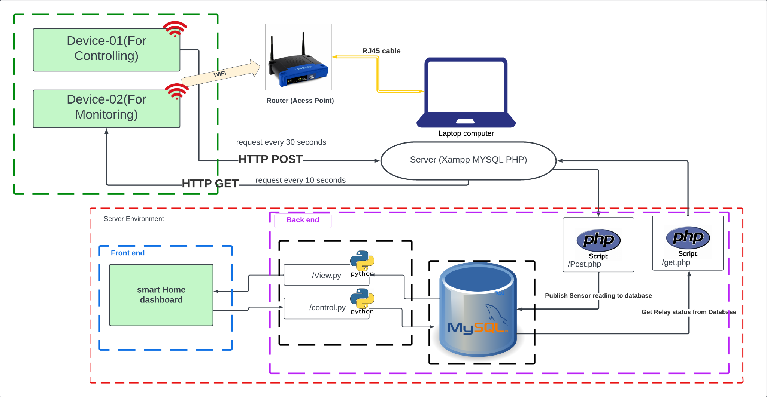
Smart Home App
192.164.3.54
192.164.3.101
192.164.3.100

Slide 19
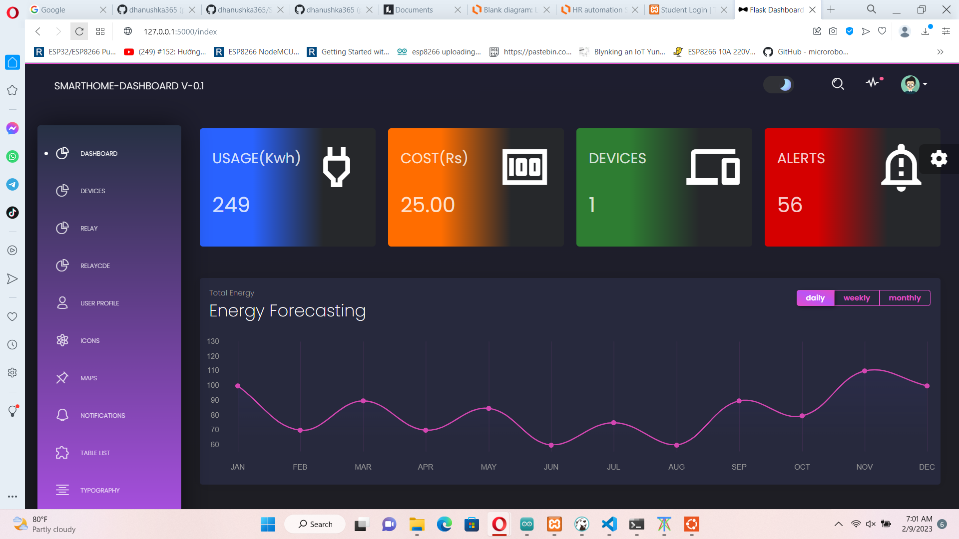
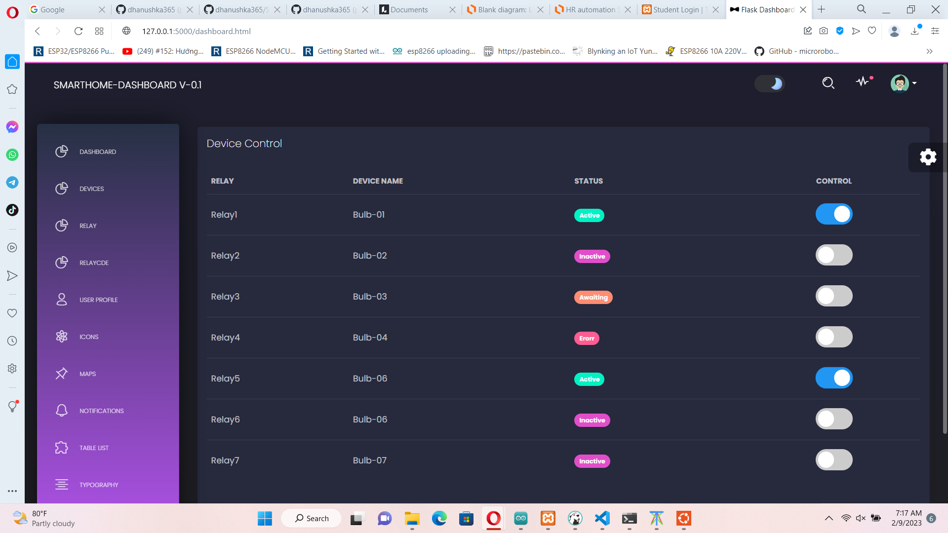
Smart Home App(ongoing)
Planned Main dashboard view see sensor info
Planned Device control dashboard view

Slide 20
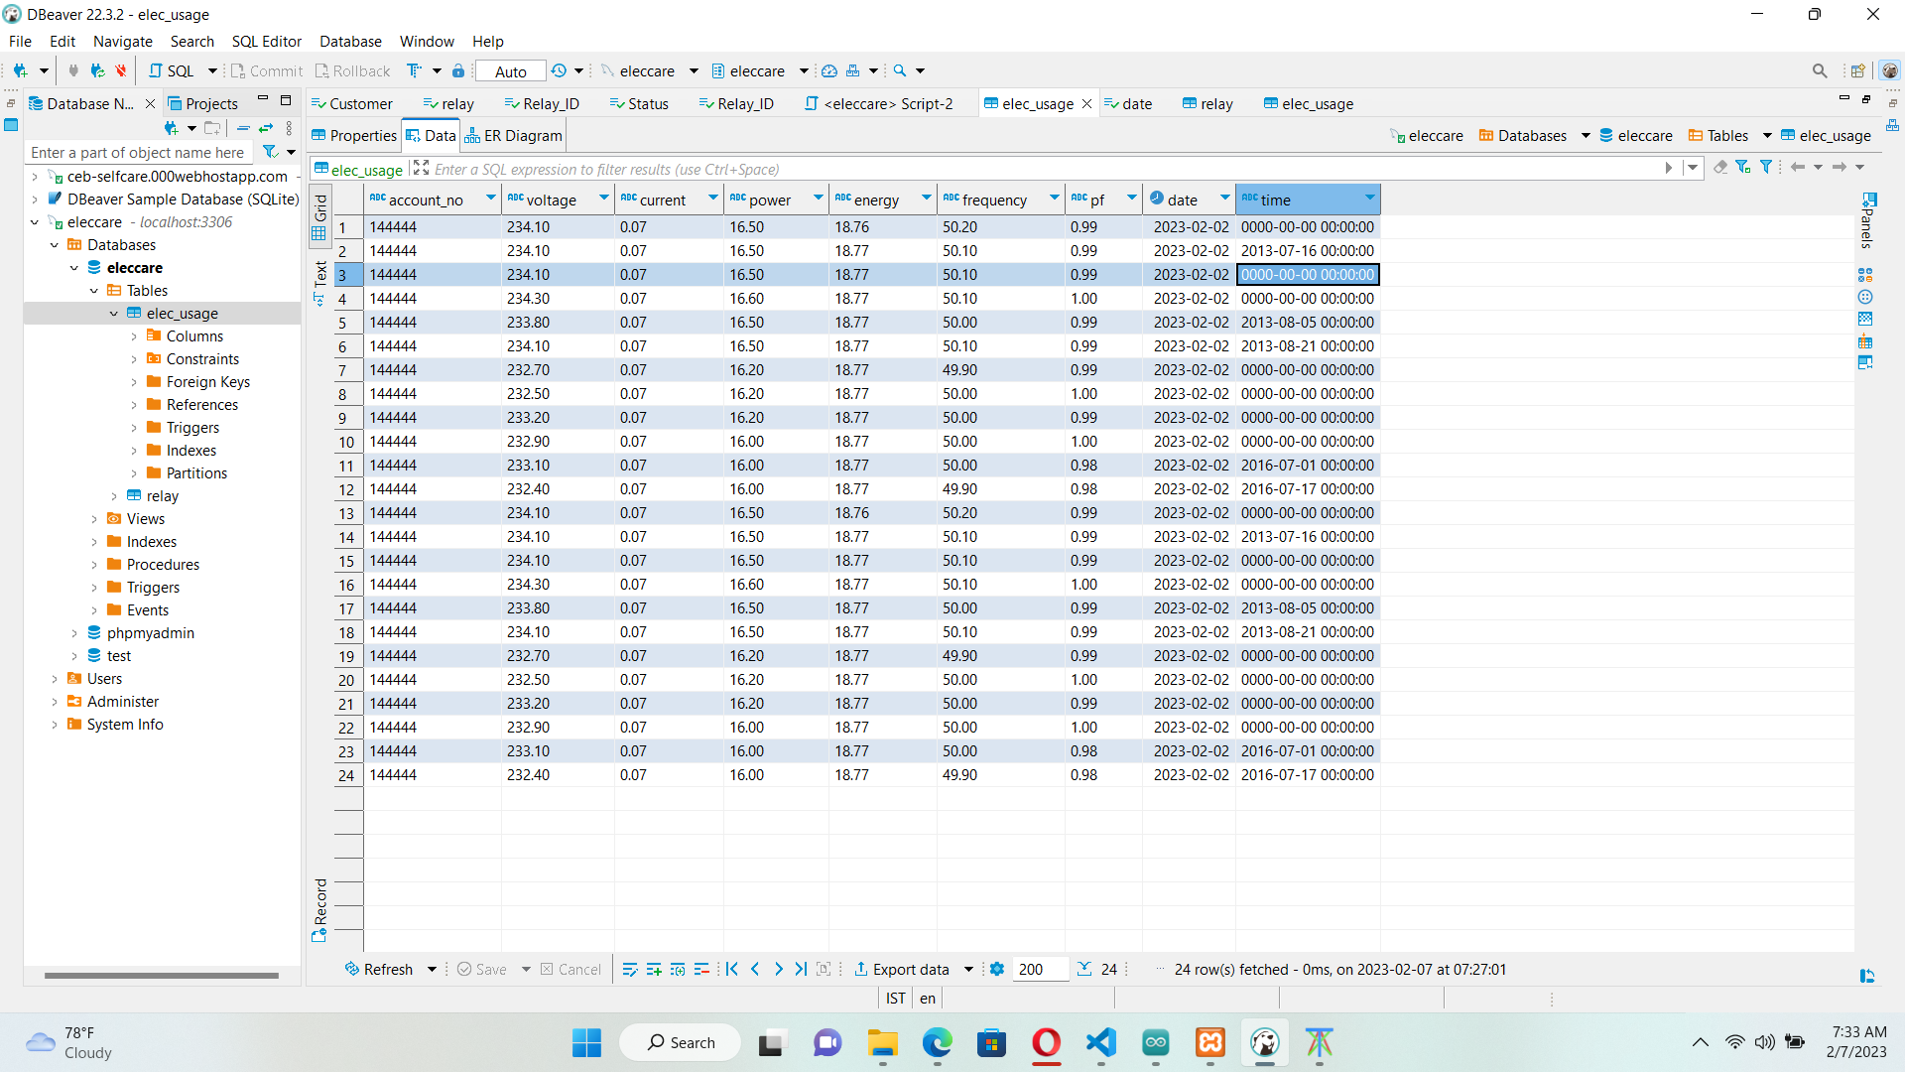
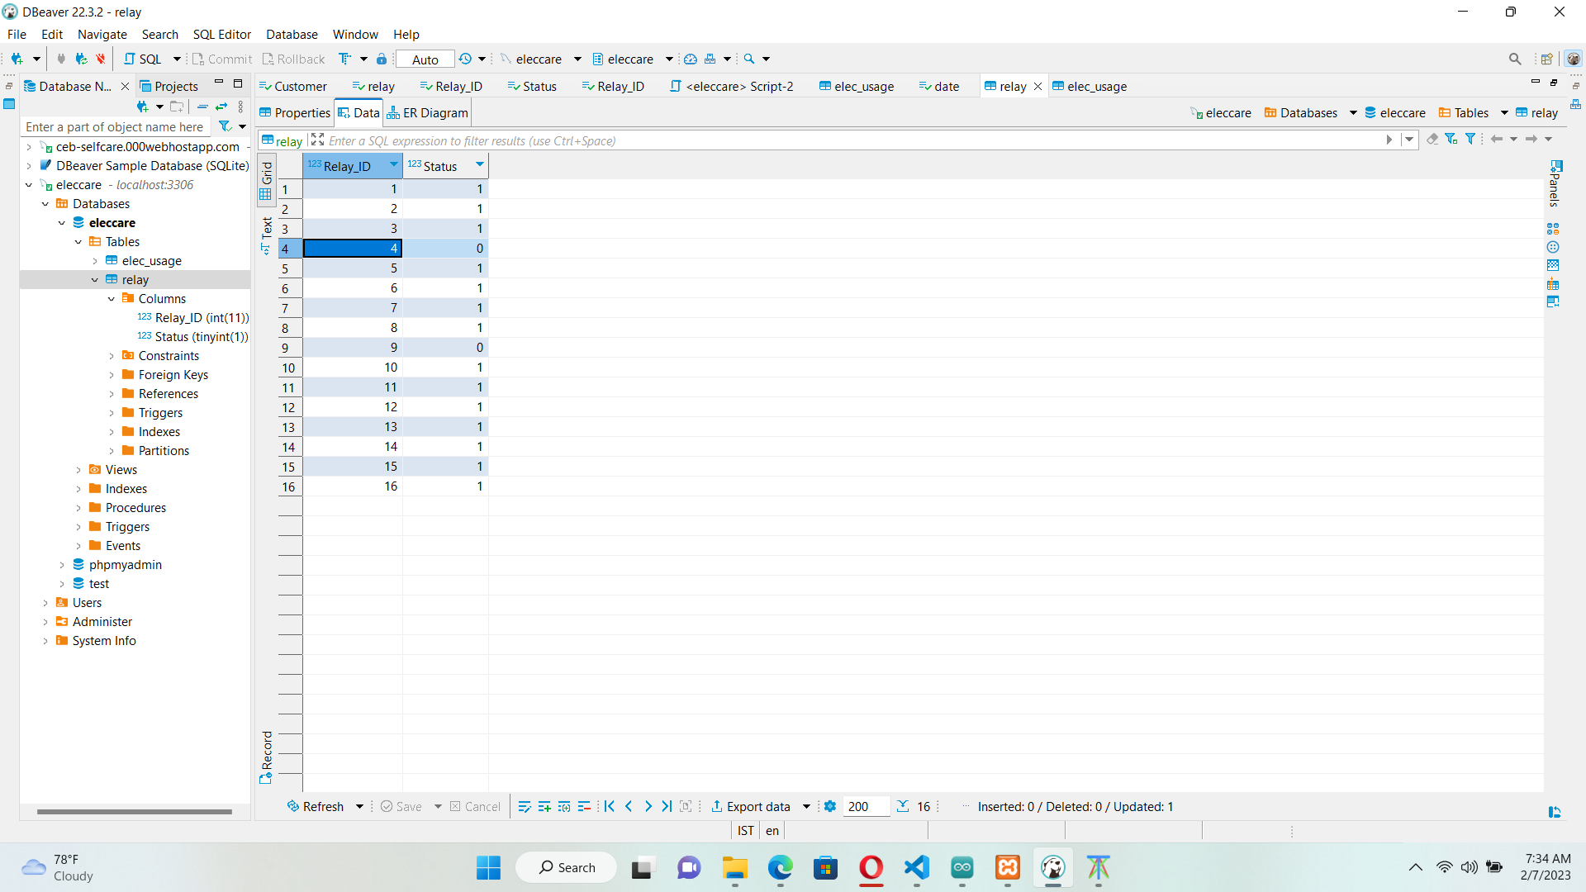
Databases for the prototyped devices
Sensor data gathered to Local MySQL database
Relay control Local MySQL database

Slide 21
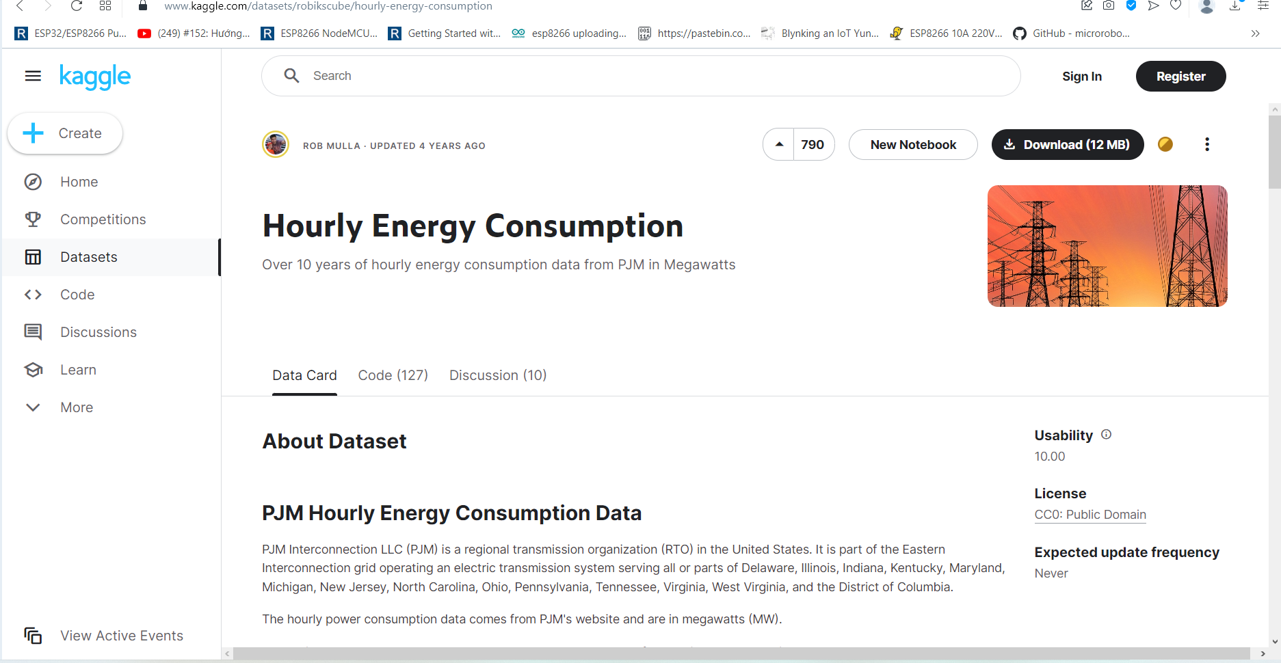
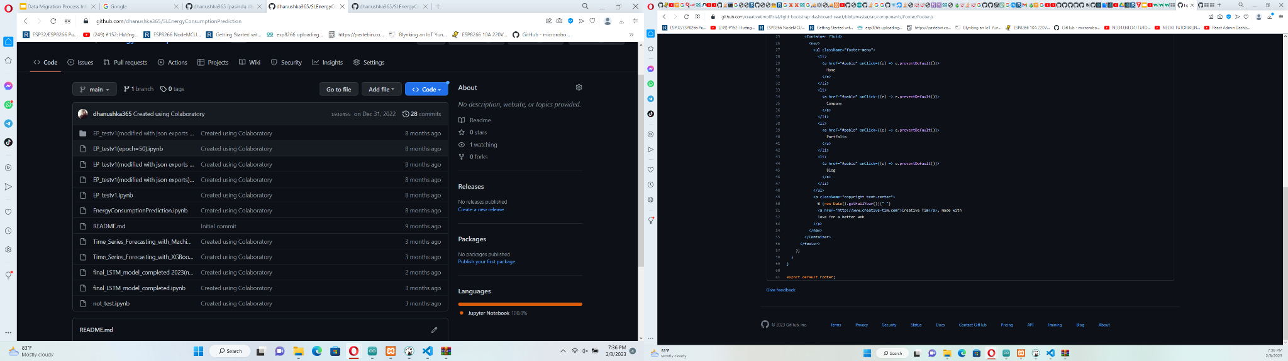
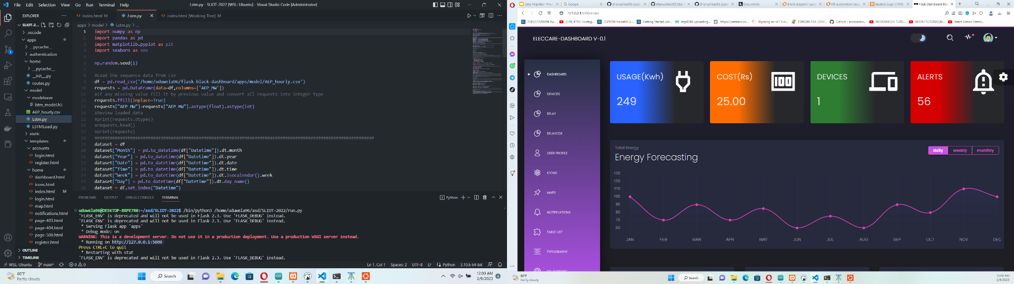
Energy Prediction Model
Predicting the single user’s energy consumption using Long Short-Term Memory (LSTM) .
Detecting Anomalies in the usage patterns according to given threshold values.
Current model accuracy score obtained around 91%.
If we had enough time we will add this forecasting feature also.
Used Online available dataset to build and trained the forecasting model
Model Progress Commit on github
Model trained and saved to .h5 file

Slide 22
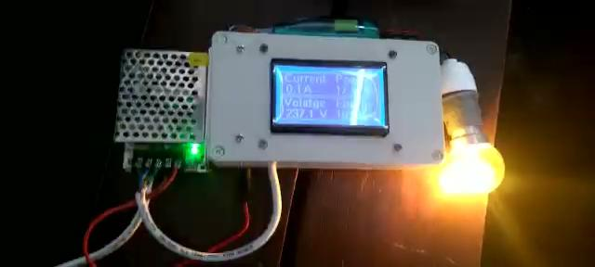
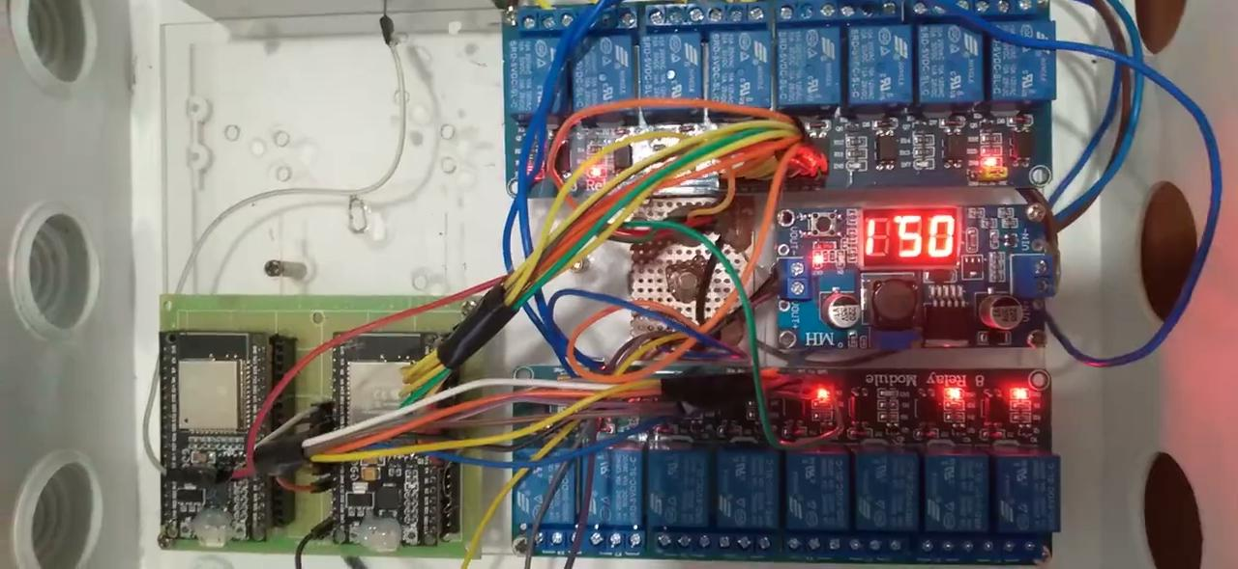
Our Prototypes
For Energy Metering
For appliances controlling(re-modifying)

Slide 23
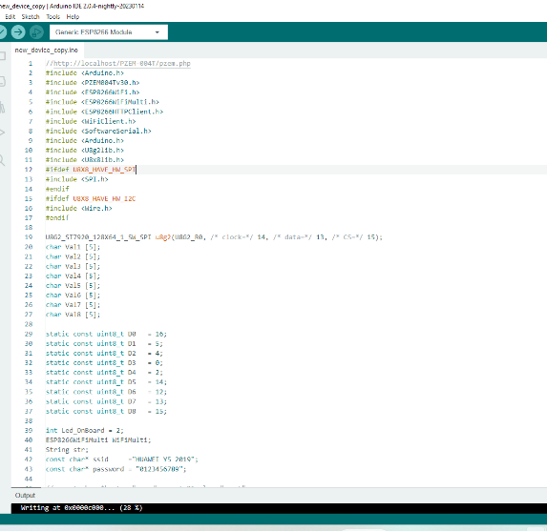
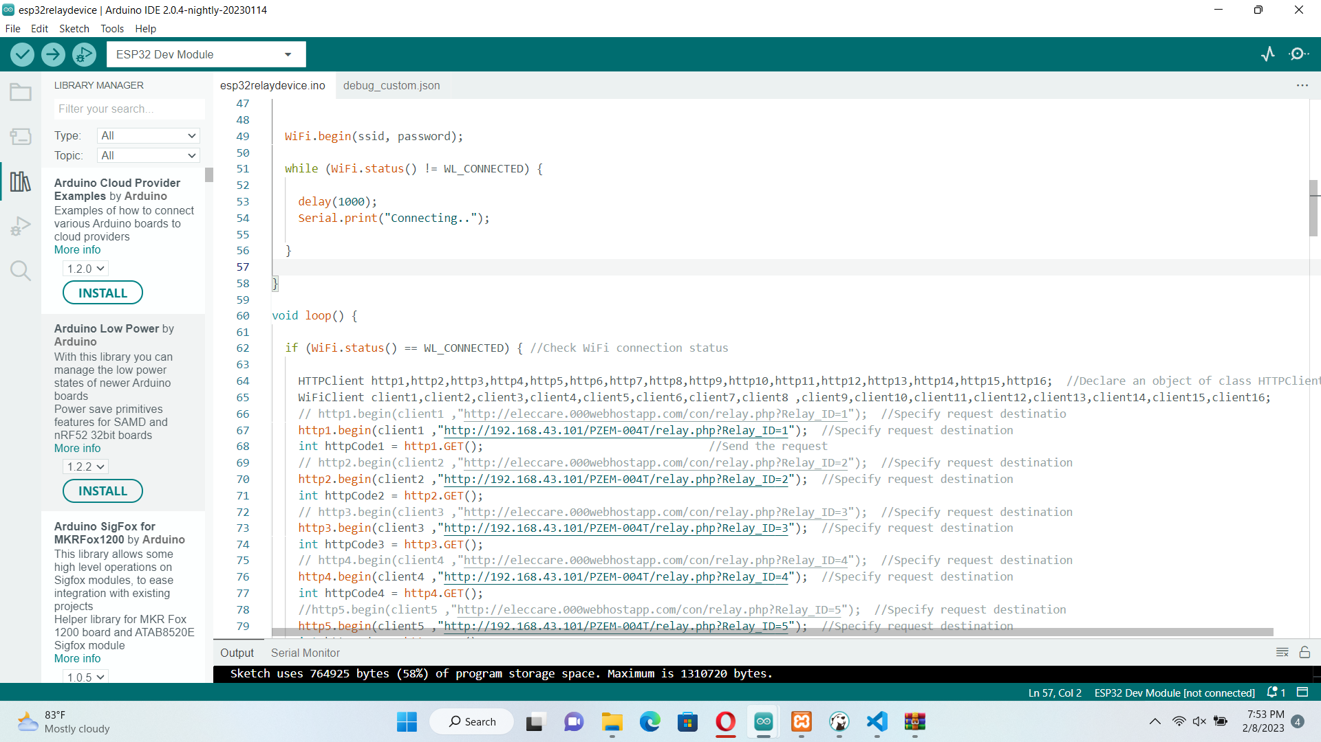
Device Arduino Codes
Arduino code for appliance controlling device
Arduino code for electricity monitoring device

Slide 24
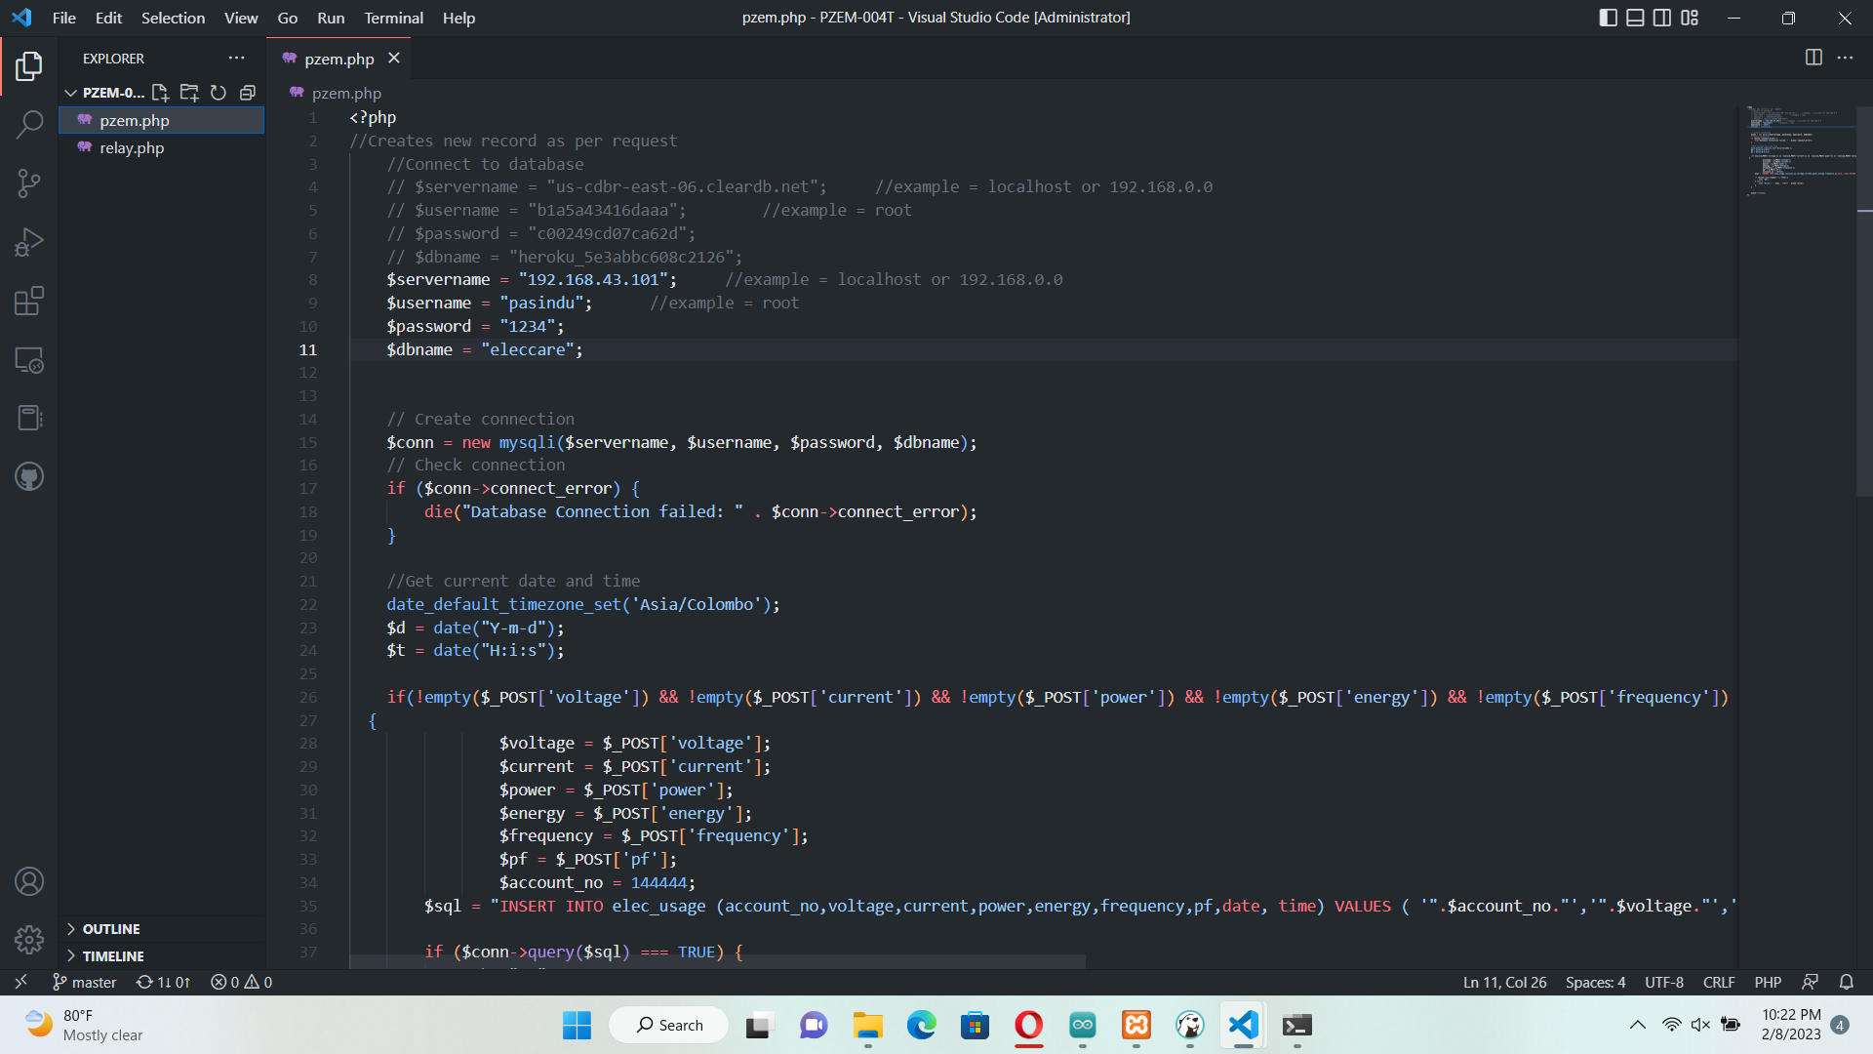
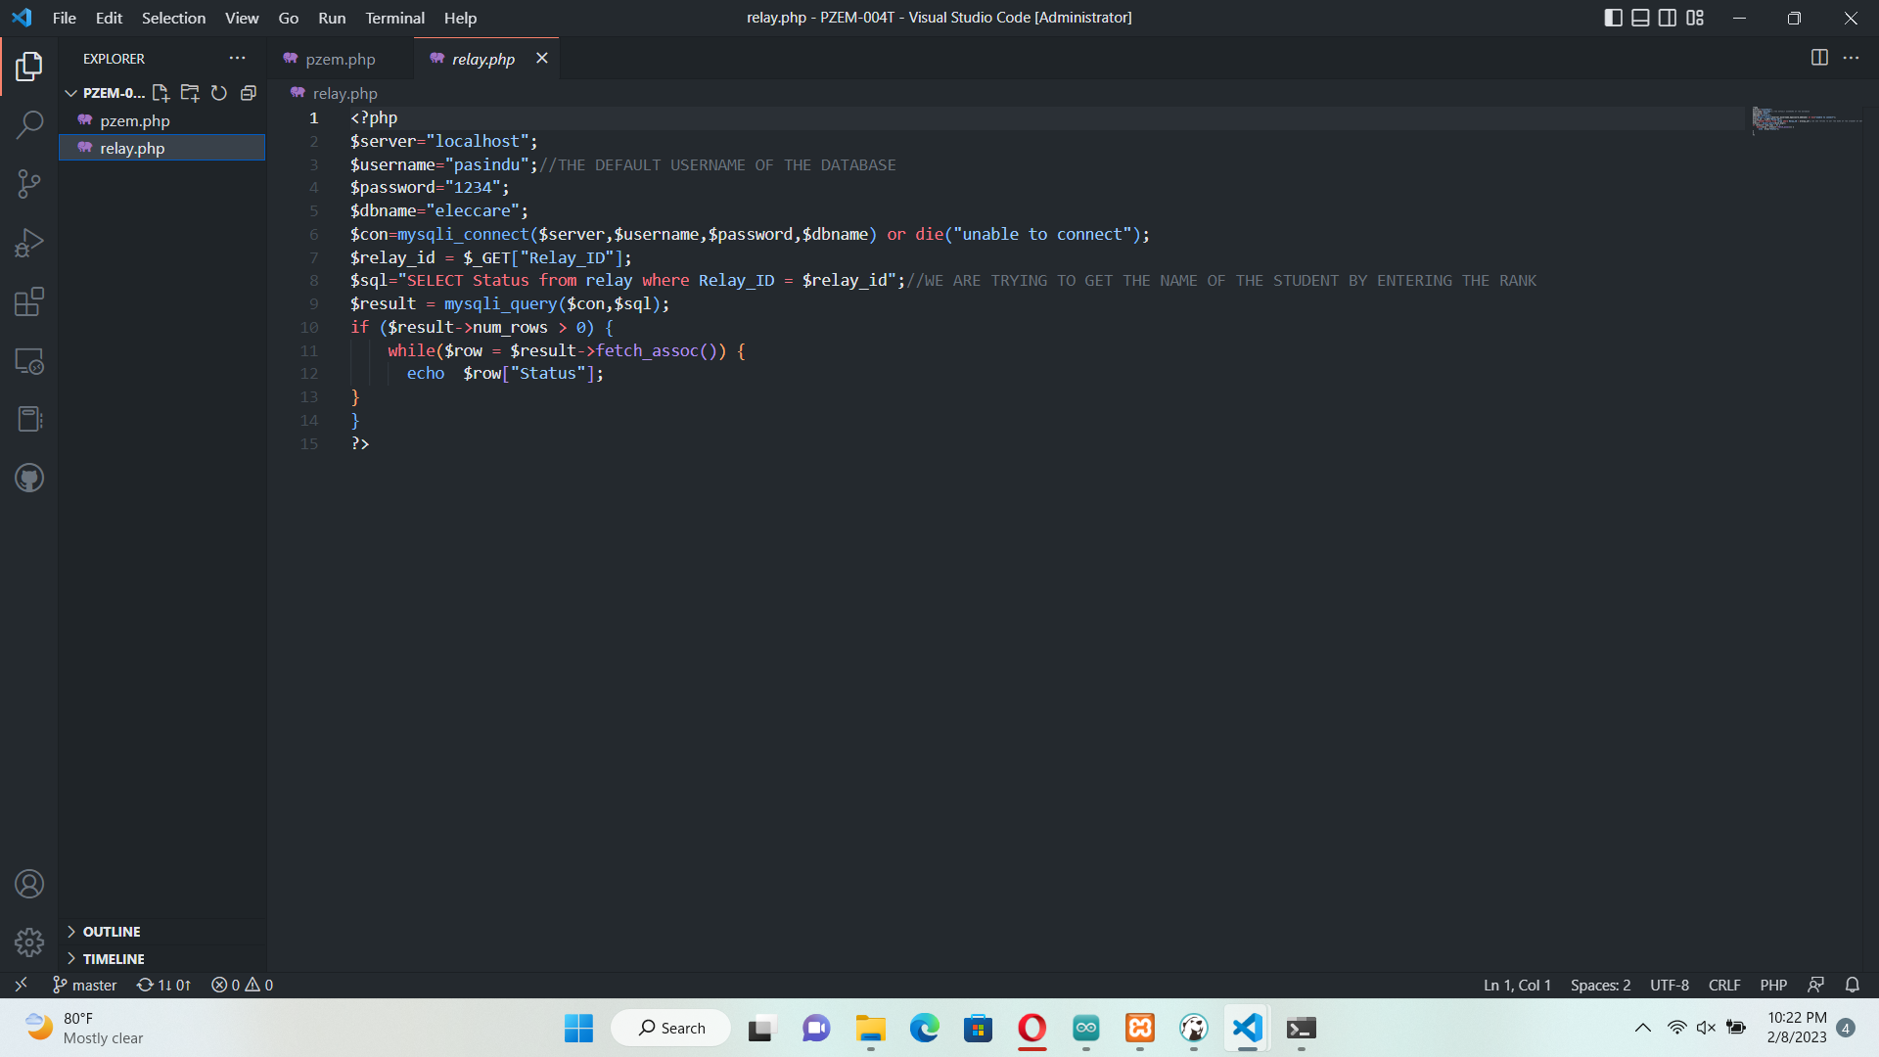
PHP database Connectors Running On Server
PHP code for energy metering device
PHP code for appliance controlling device

Slide 25
Conclusion
WLAN edge computing provides benefits such as improved performance and reduced latency through processing data and running applications closer to end-users.
It increases reliability by providing a backup option in case of network outages and enhances security by processing sensitive information locally.
WLAN edge computing provides a more efficient and secure solution for surveillance video processing and smart home applications.

Slide 26
Next Steps
Remaining Tasks for next 3 months | 1 | 2 | 3 | 4 | 5 | 6 | 7 | 8 | 9 | 10
Video surveillance application model data is to be stored in a database.
Database data will be shown in the dashboard using meaningful tables and charts
Email notification or alarm mechanism for intruder detections and abnormal human behaviour identification.
Complete main dashboard view and relay control dashboard view with proper database connections
Add the the forecasting model to the back-end repository and plot graphs.
Testing the whole application and adding more features
Preparing Final reports and Articles

Slide 27
Q & A

Slide 28
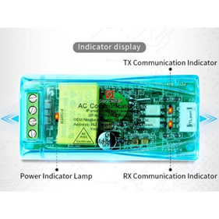
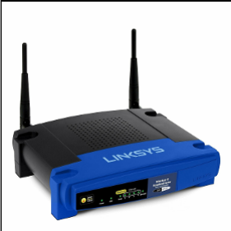
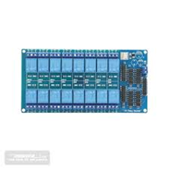

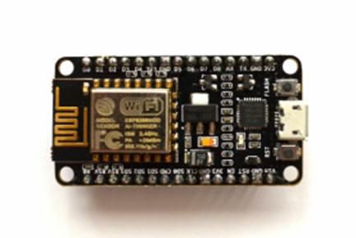
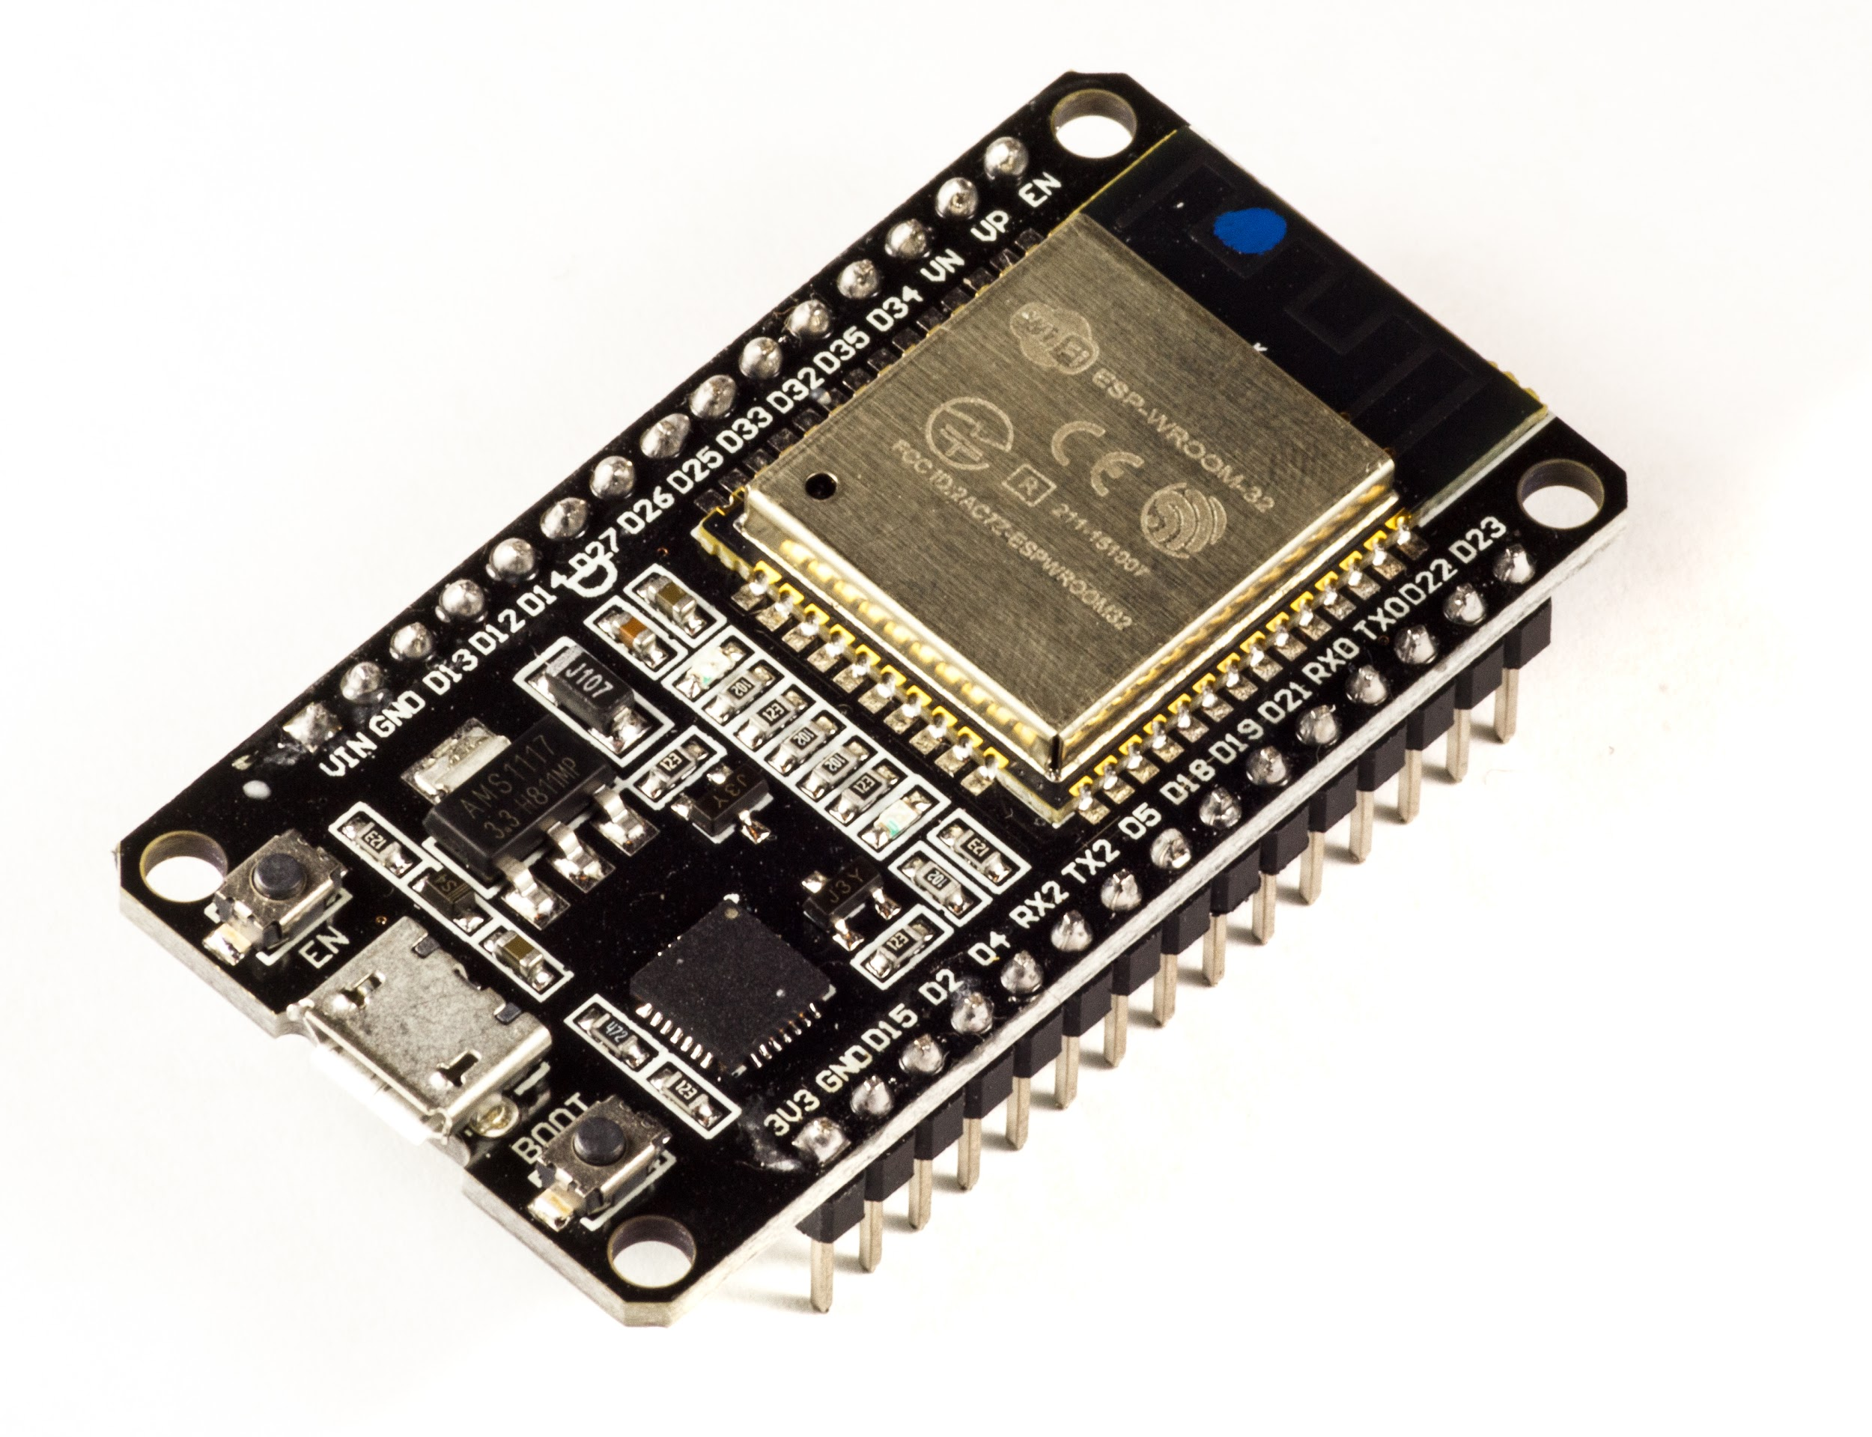
Components used to our project
5V relay module
Home Broadband Router
New PZEM -004T v3 100 A module + Split Current Transformer
Raspberry pi model 3b+
ESP32 and ESP8266 NodeMCU development board

Slide 29
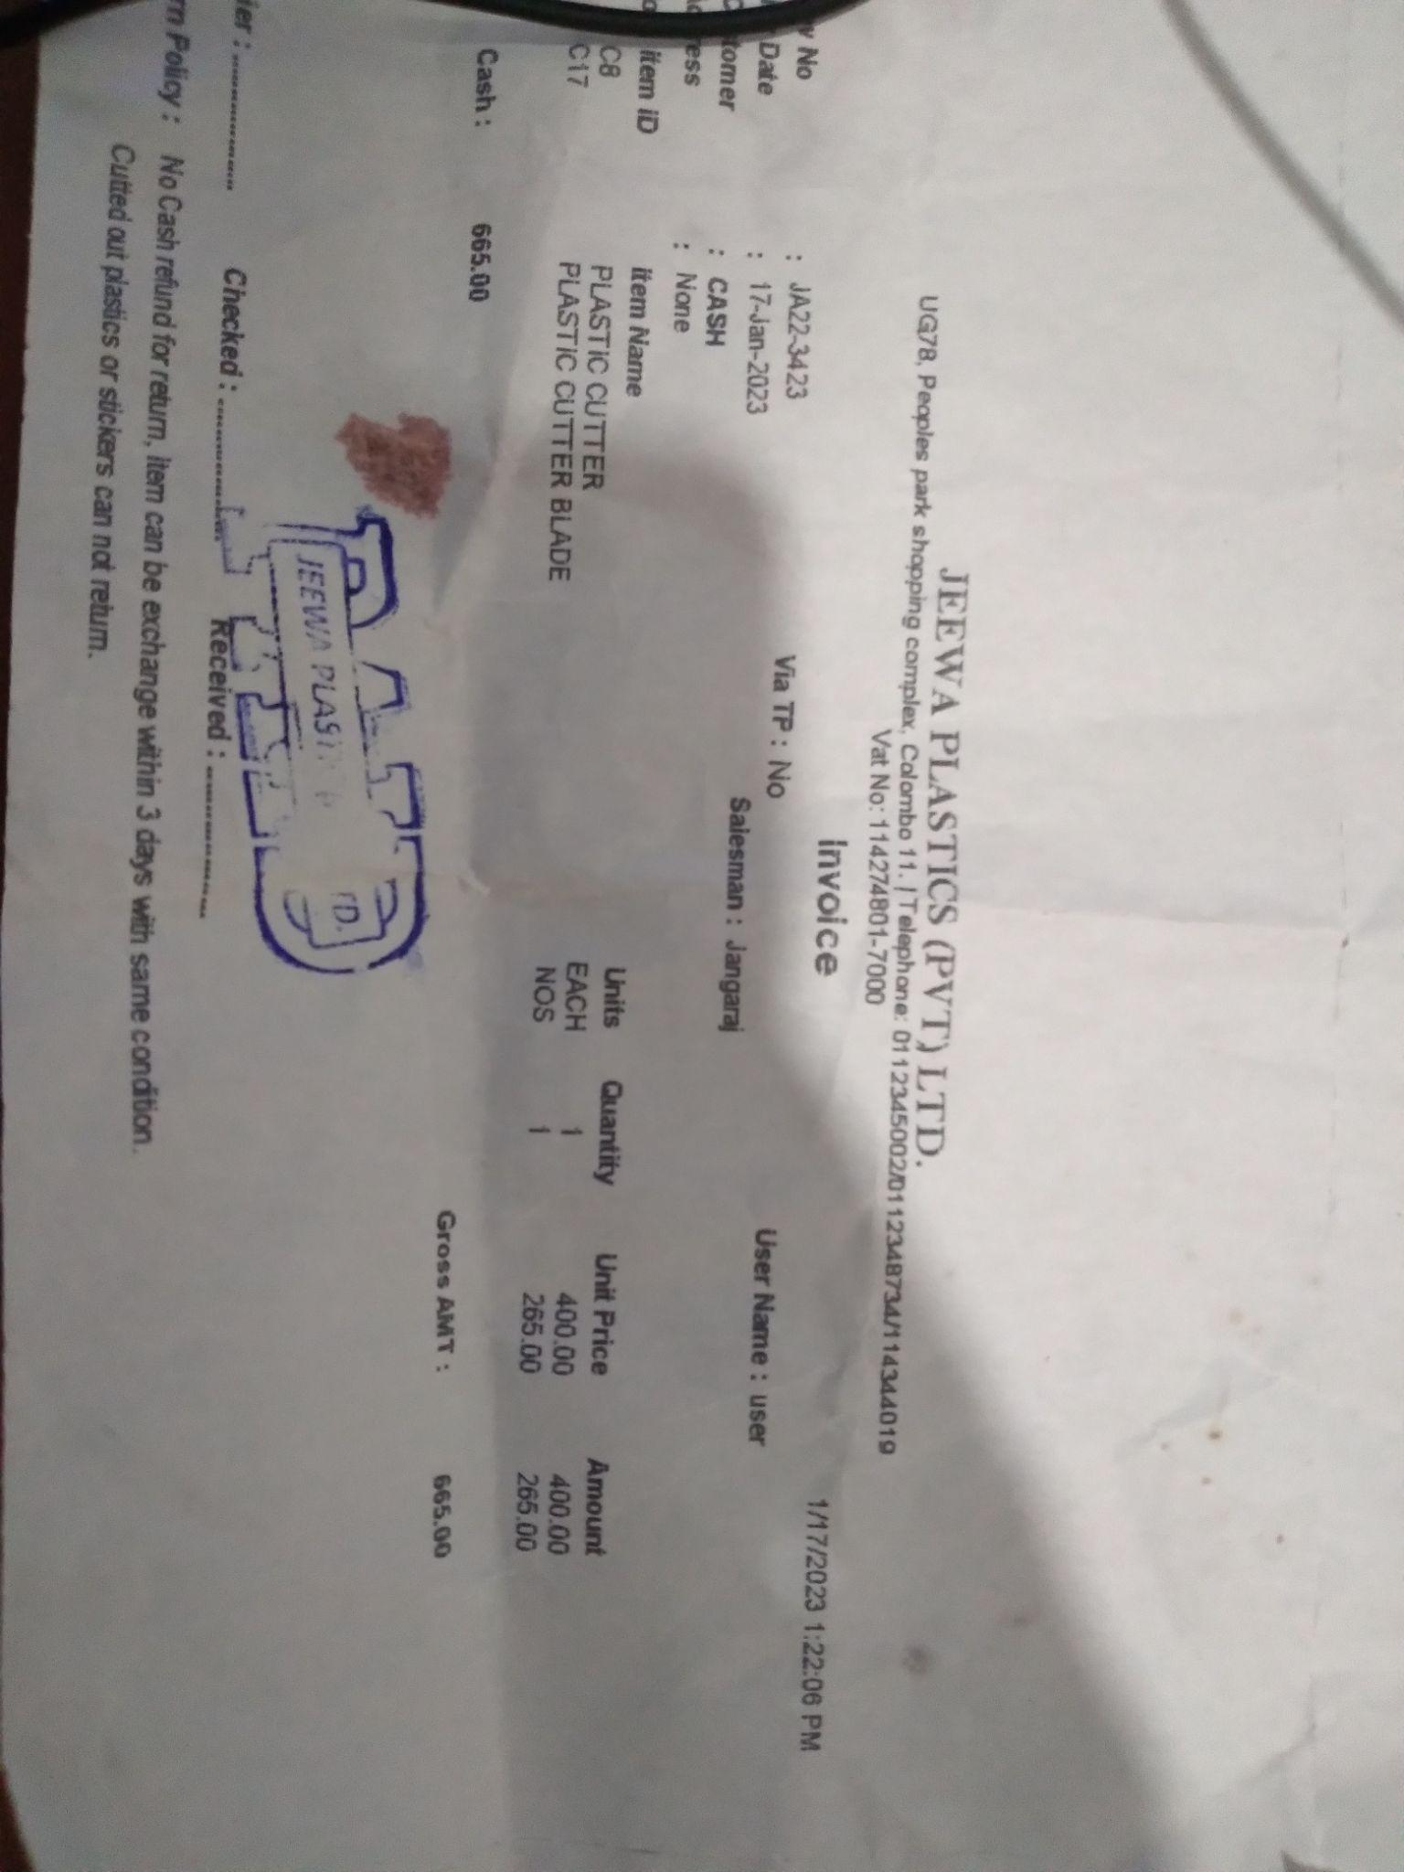
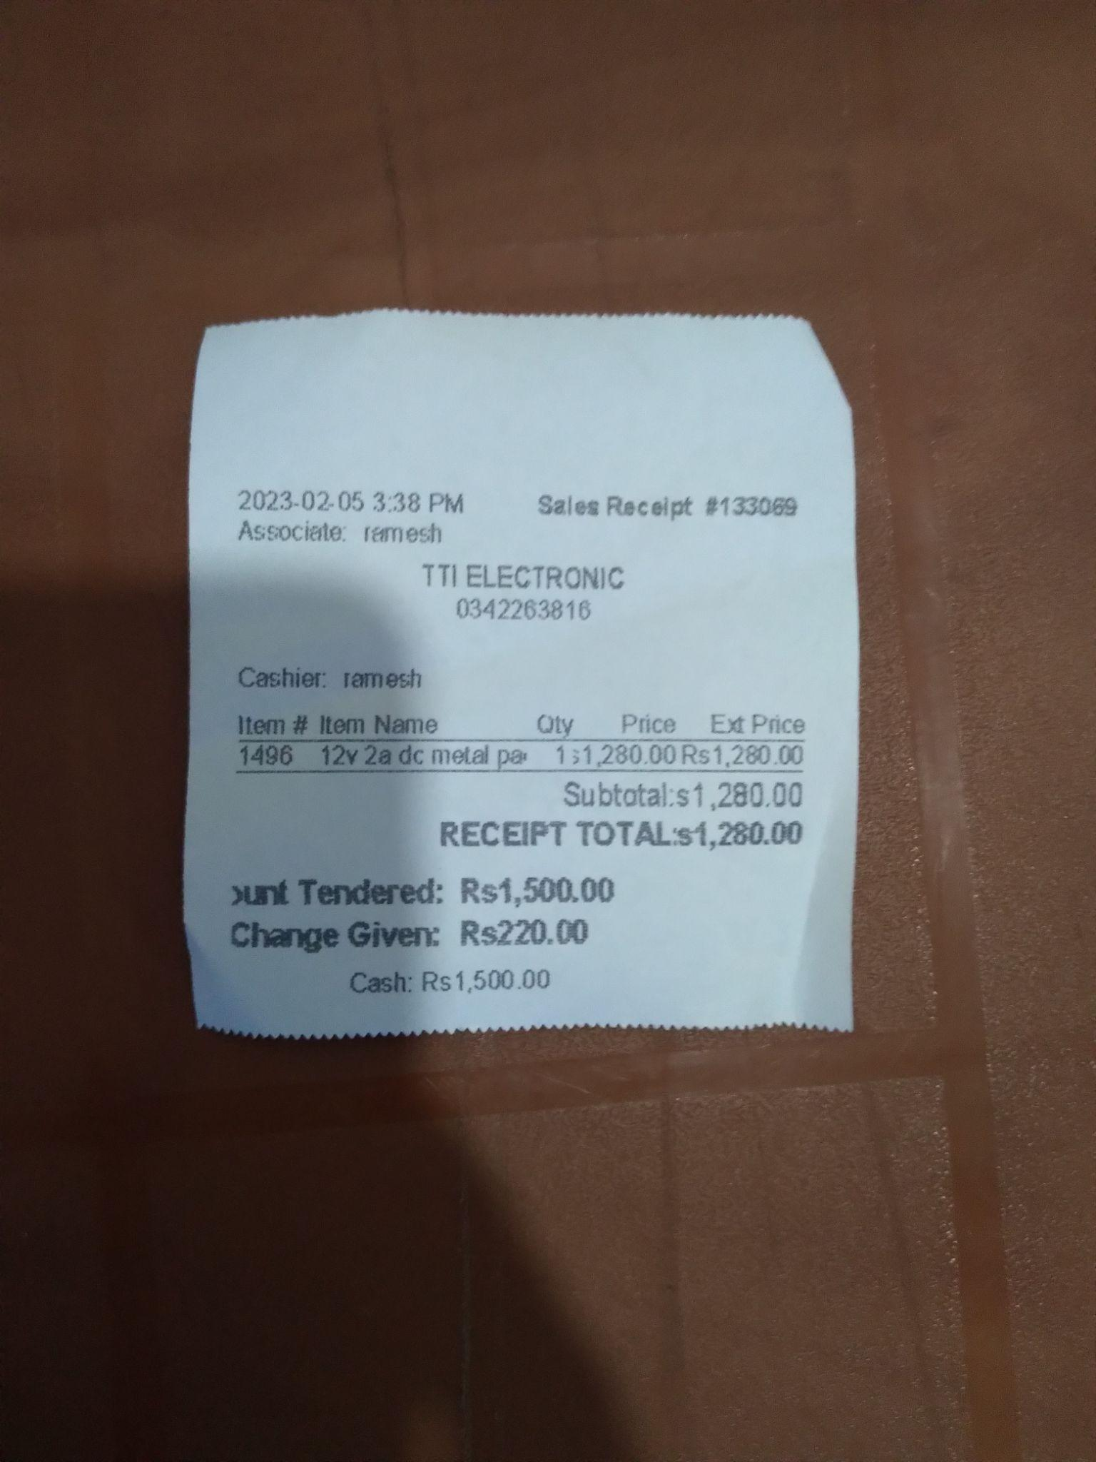
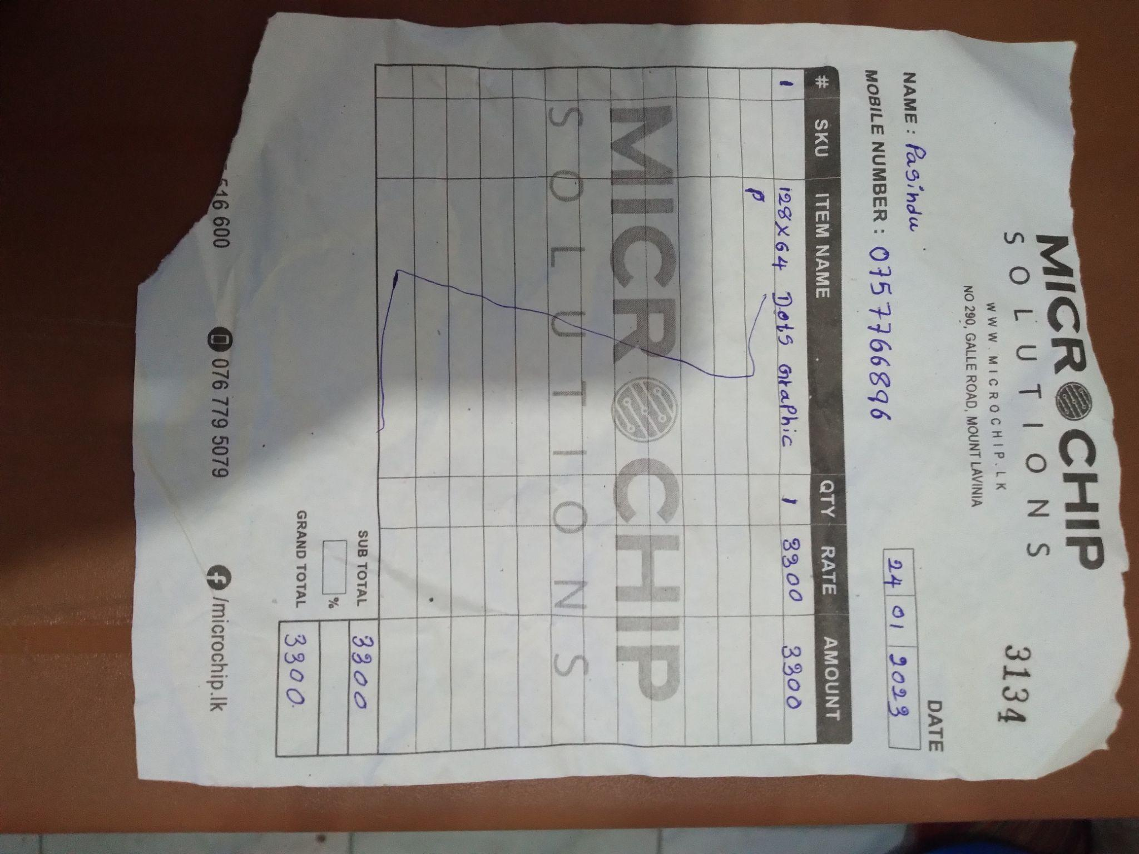
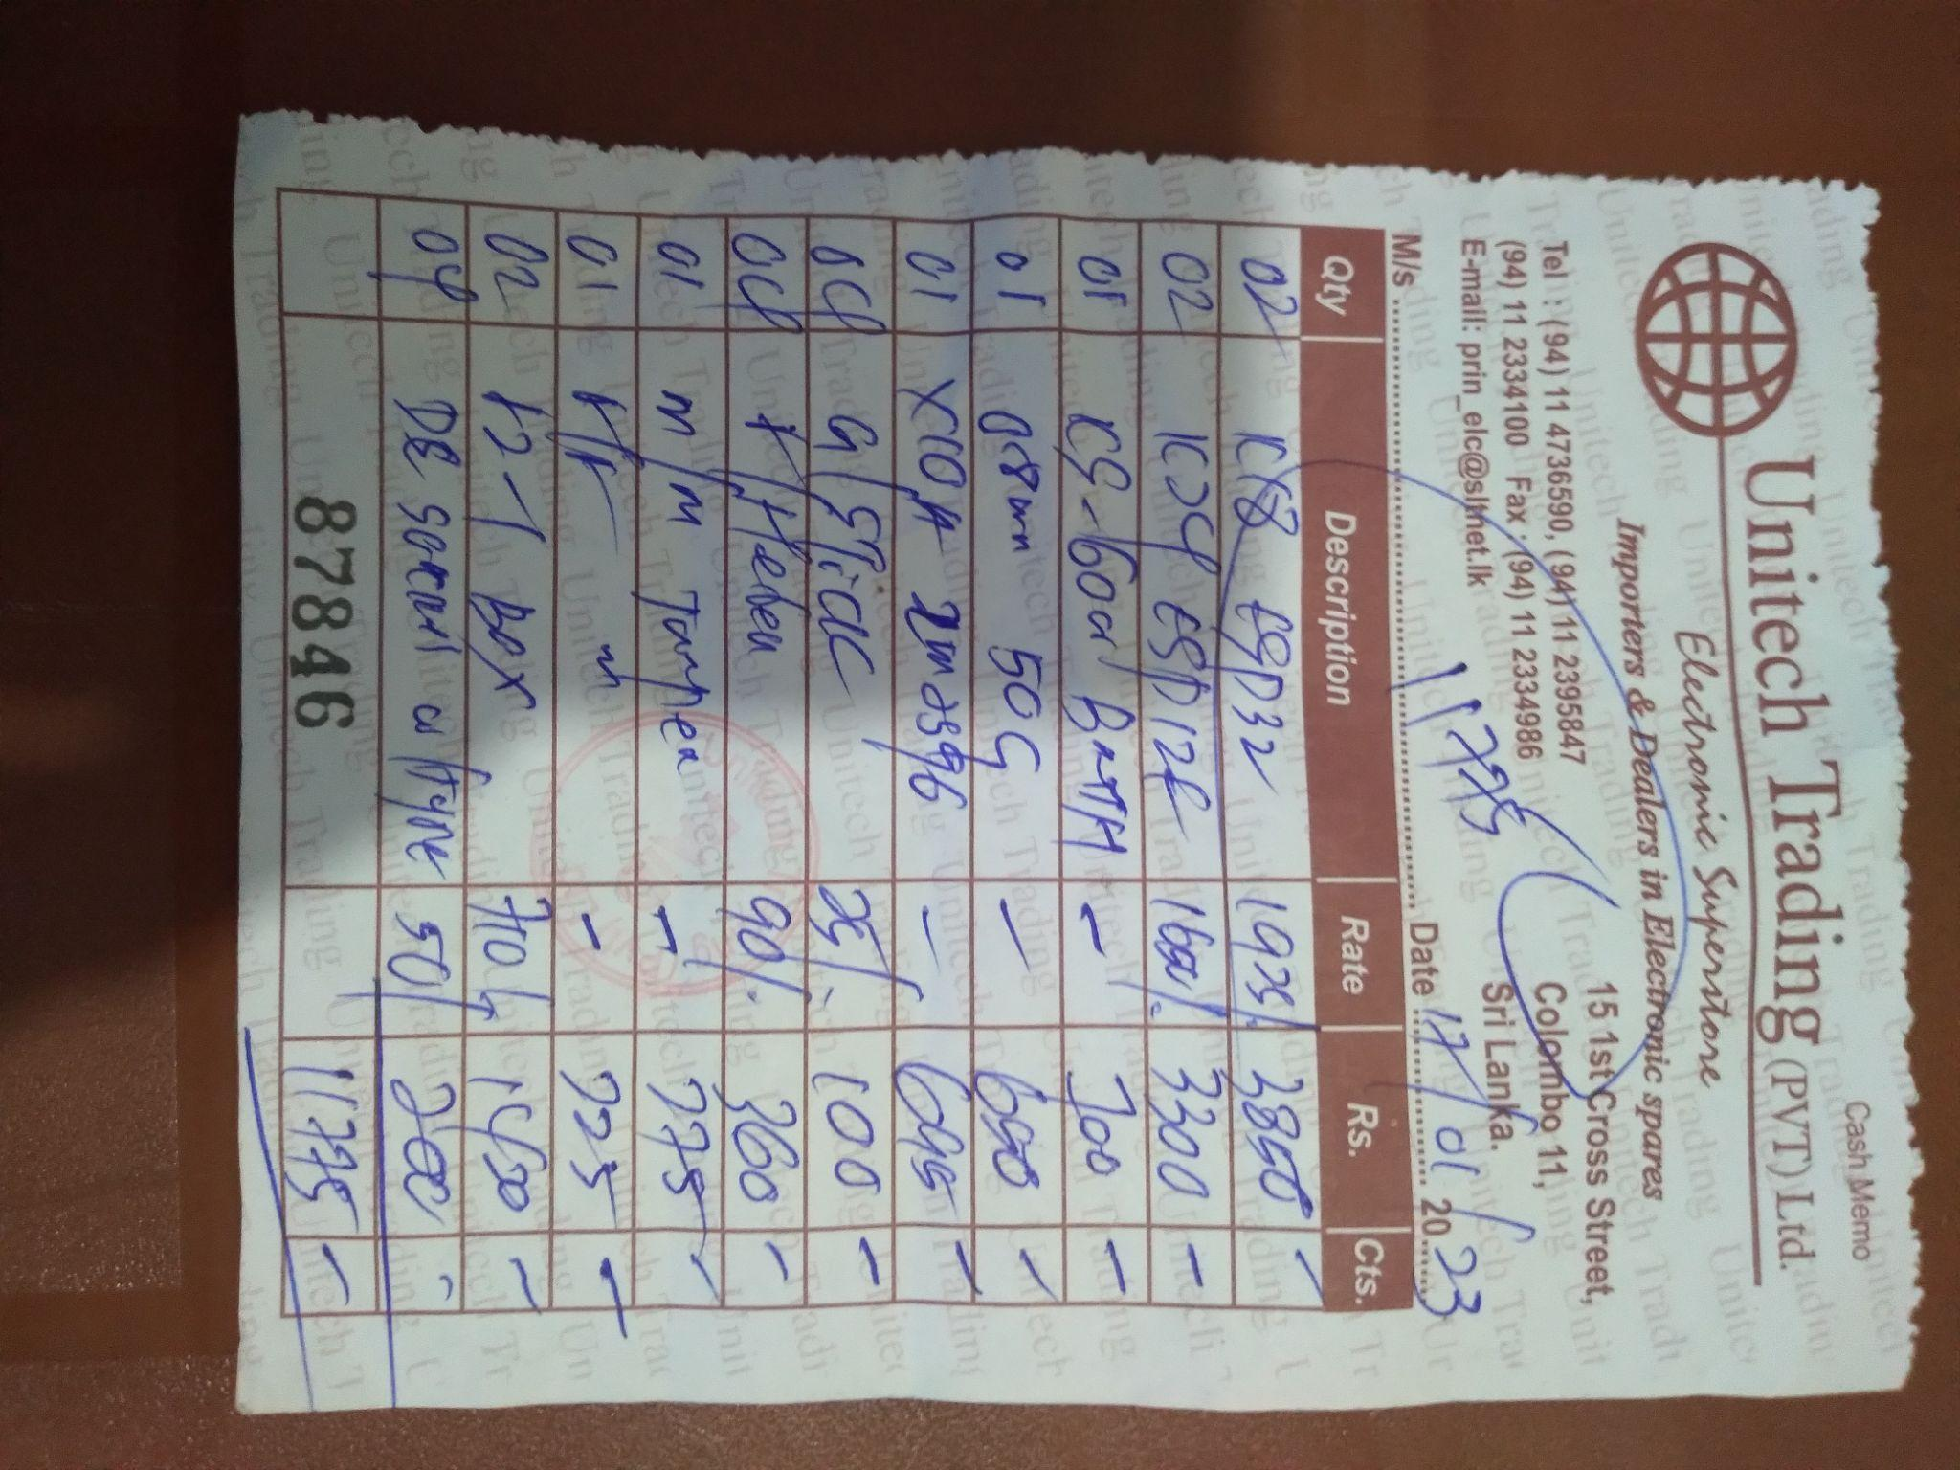
Budget for smart Home App remodification and For new device

